Slide 1
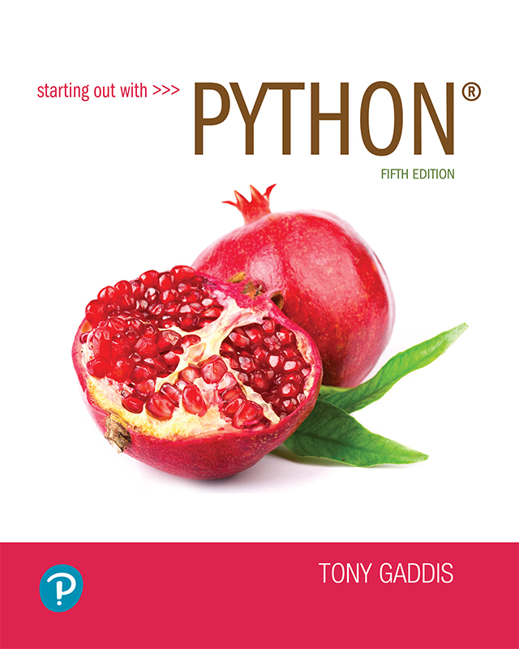
Starting out with Python
Fifth Edition
Chapter 5
Functions
Copyright © 2021, 2018, 2015 Pearson Education, Inc. All Rights Reserved

Slide 2
Topics (1 of 2)
Introduction to Functions
Defining and Calling a Void Function
Designing a Program to Use Functions
Local Variables
Passing Arguments to Functions
Global Variables and Global Constants
Turtle Graphics: Modularizing Code with Functions

Slide 3
Topics (2 of 2)
Introduction to Value-Returning Functions: Generating Random Numbers
Writing Your Own Value-Returning Functions
The math Module
Storing Functions in Modules

Slide 4
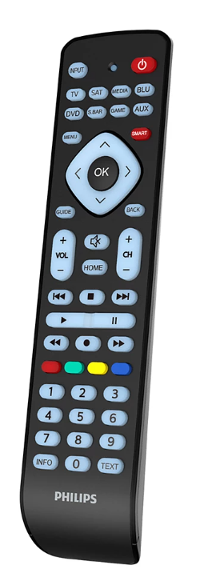
Introduction to Functions (1 of 2)
Function: group of statements within a program that perform as specific task
Usually one task of a large program
Functions can be executed in order to perform overall program task
Known as divide and conquer approach
Modularized program: program wherein each task within the program is in its own function

Slide 5
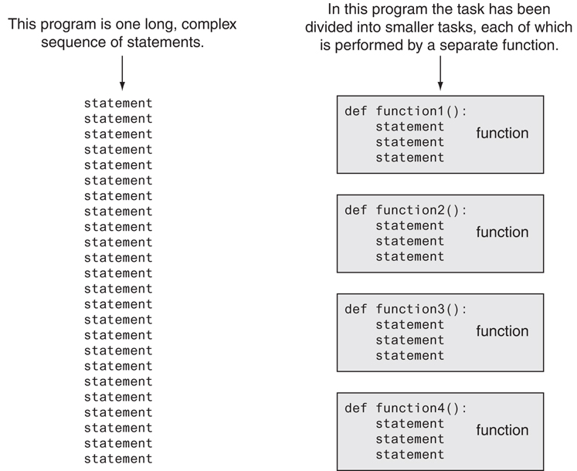
Introduction to Functions (2 of 2)
Figure 5-1 Using functions to divide and conquer a large task

Slide 6
Benefits of Modularizing a Program with Functions
The benefits of using functions include:
Simpler code
Code reuse
write the code once and call it multiple times
Better testing and debugging
Can test and debug each function individually
Faster development
Easier facilitation of teamwork
Different team members can write different functions

Slide 7
Void Functions and Value-Returning Functions
A void function:
When you call a void function, it simply executes the statements it contains and then terminates.
A value-returning function:
Executes the statements it contains, and then it returns a value back to the statement that called it.
The input, int, and float functions are examples of value-returning functions.

Slide 8
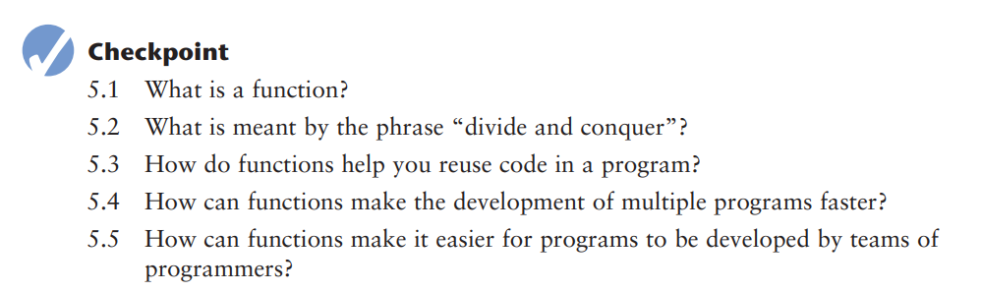

Slide 9
Defining and Calling a Function (1 of 5)
Functions are given names
Function naming rules:
Cannot use keywords as a function name
Cannot contain spaces
First character must be a letter or underscore
All other characters must be a letter, number or underscore
Uppercase and lowercase characters are distinct

Slide 10
Defining and Calling a Function (2 of 5)
Function name should be descriptive of the task carried out by the function
Often includes a verb
Function definition: specifies what function does
def function_name():
statement
statement

Slide 11
Defining and Calling a Function (3 of 5)
Function header: first line of function
Includes keyword def and function name, followed by parentheses and colon
Block: set of statements that belong together as a group
Example: the statements included in a function

Slide 12
Example 1
def message(): print('I am Mohamed,') print('Your best friend .') message()

Slide 13
Defining and Calling a Function (4 of 5)
Call a function to execute it
When a function is called:
Interpreter jumps to the function and executes statements in the block
Interpreter jumps back to part of program that called the function
Known as function return

Slide 14
Defining and Calling a Function (5 of 5)
main function: called when the program starts
Calls other functions when they are needed
Defines the mainline logic of the program

Slide 15
Example 2
def main():
print(‘I have a message for you,’)
message()
print(‘Goodbye !,’)
def message():
print('I am Mohamed,') print('Your best friend .') main()

Slide 16
Indentation in Python
Each block must be indented
Lines in block must begin with the same number of spaces
Use tabs or spaces to indent lines in a block, but not both as this can confuse the Python interpreter
IDLE automatically indents the lines in a block
Blank lines that appear in a block are ignored

Slide 17
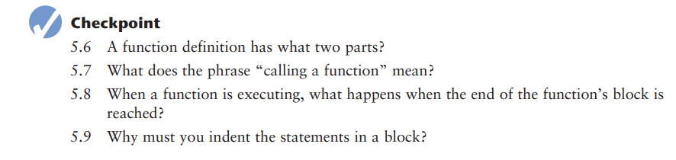

Slide 18
Designing a Program to Use Functions (1 of 5)
In a flowchart, function call shown as rectangle with vertical bars at each side
Function name written in the symbol
Typically draw separate flow chart for each function in the program
End terminal symbol usually reads Return
Top-down design: technique for breaking algorithm into functions

Slide 19
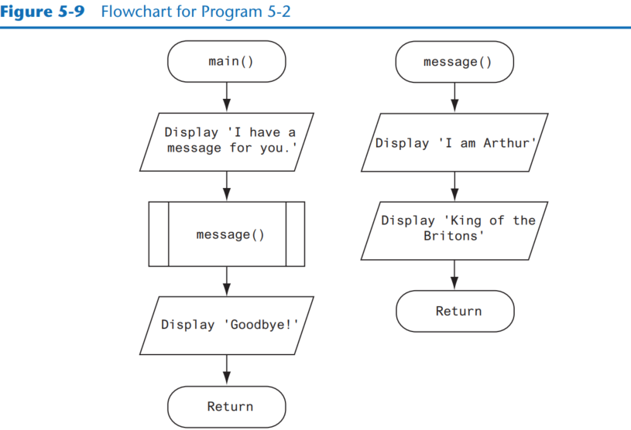
Designing a Program to Use Functions (2 of 5)

Slide 20
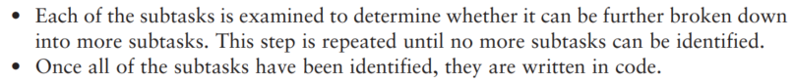
Designing a Program to Use Functions (3 of 5)
The process of top-down design is performed in the following manner:
This process is called top-down design because the programmer begins by looking at the topmost level of tasks that must be performed and then breaks down those tasks into lower levels of subtasks.

Slide 21
Designing a Program to Use Functions (4 of 5)
Hierarchy chart: depicts relationship between functions
AKA structure chart
Box for each function in the program, Lines connecting boxes illustrate the functions called by each function
Does not show steps taken inside a function
Use input function to have program wait for user to press enter

Slide 22
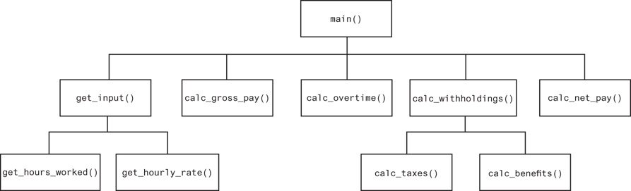
Designing a Program to Use Functions (5 of 5)
Figure 5-10 A hierarchy chart

Slide 23
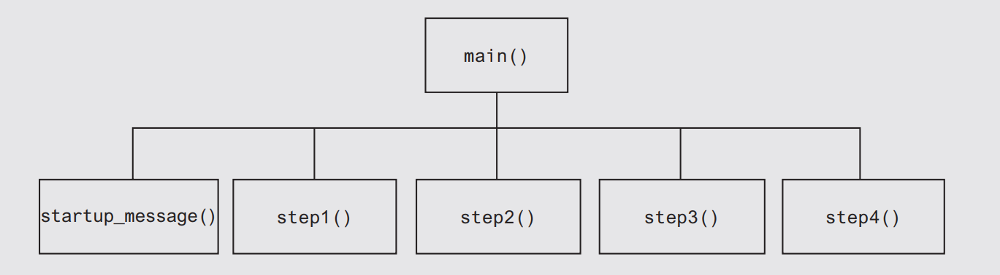
This design shows the steps inside the function

Slide 24
def main(): startup_message() input('Press enter to see step 1: ') step1() input('Press enter to see step 2: ') step2() input('Press enter to see step 3:') step3() input('Press enter to see step 4:') step4() input('Press enter to see step 5:') step5() def startup_message(): print('this program shows how to make tea') print('the are 5 simple steps') print() def step1(): print('Step1: Heat water until it boils') print() def step2(): print('Step 2: Put tea leaves in a cup') print() def step3(): print('Step 3: Pour the hot water into the cup') print() def step4(): print('Step 4: Wait for a few minutes to let the tea mix with the water ') print() def step5(): print('Step 5: Add sugar or milk if you like, then enjoy your tea!') main()

Slide 25
Using the pass Keyword
You can use the pass keyword to create empty functions
The pass keyword is ignored by the Python interpreter
This can be helpful when designing a program
def step1():
pass
def step2():
pass

Slide 26
Local Variables (1 of 2)
Local variable: variable that is assigned a value inside a function
Belongs to the function in which it was created
Only statements inside that function can access it, error will occur if another function tries to access the variable
Scope: the part of a program in which a variable may be accessed
For local variable: function in which created

Slide 27
Local Variables (2 of 2)
Local variable cannot be accessed by statements inside its function which precede its creation
Different functions may have local variables with the same name
Each function does not see the other function’s local variables, so no confusion

Slide 28
Example
def main(): get_name()
print(f'Hello {name}’) Error def get_name(): name=input("Enter your name: ") main()

Slide 29
Example
def main(): hayat_market() jubba_market() def hayat_market(): branch=3 print(f'hayat market has {branch} branches') def jubba_market(): branch=2 print(f'Jubba market has {branch} branches') main()

Slide 30
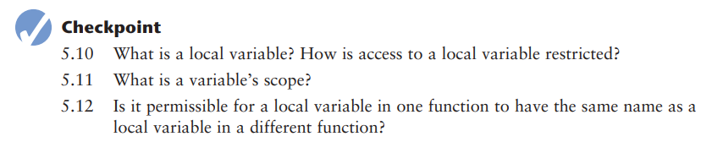

Slide 31
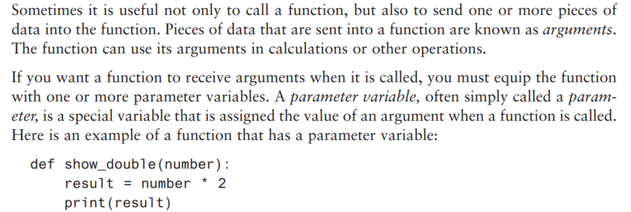
Passing Arguments to Functions (1 of 4)

Slide 32
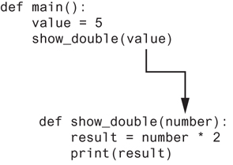
Passing Arguments to Functions (2 of 4)
Figure 5-13 The value variable is passed as an argument

Slide 33
Passing Arguments to Functions (3 of 4)
Parameter variable: variable that is assigned the value of an argument when the function is called
The parameter and the argument reference the same value
General format:
def function_name(parameter):
Scope of a parameter: the function in which the parameter is used

Slide 34
Example
def main(): print("This program displays the conversion of miles to kilometers") print("The formula is 1 mile is equal to 1.60934 kilometers") print() miles = float(input('Enter the miles you needed: ')) miles_to_km(miles) def miles_to_km(value): kilometers = value * 1.60934 print(f'{value} miles is equal to {kilometers:.2f} kilometers') main()

Slide 35
Passing Multiple Arguments (1 of 2)
Python allows writing a function that accepts multiple arguments
Parameter list replaces single parameter
Parameter list items separated by comma
Arguments are passed by position to corresponding parameters
First parameter receives value of first argument, second parameter receives value of second argument, etc.

Slide 36
Example
def main(): print("the sum of 12 and 45 is ") show_sum(12,45) def show_sum(num1,num2): result=num1+num2 print(result) main()

Slide 37
Example
def main(): num1=int(input("Enter number1:")) num2=int(input("Enter number2:")) calculate(num1,num2) print("Process finished...........") def calculate(a,b): print("The addition is :", a + b) print("The subtraction is :", a - b) print("The product is :", a * b) print("The division is :", a // b) main()

Slide 38
Making Changes to Parameters (1 of 3)
Changes made to a parameter value within the function do not affect the argument
Known as pass by value
Provides a way for unidirectional communication between one function and another function
Calling function can communicate with called function

Slide 39
Example
def main(): value=99 print(f'the value is {value}') change_me(value) print(f'Back to main value {value}') def change_me(arg): print('I am changing the value') arg=0 print(f'Now the value is {arg}') main()

Slide 40
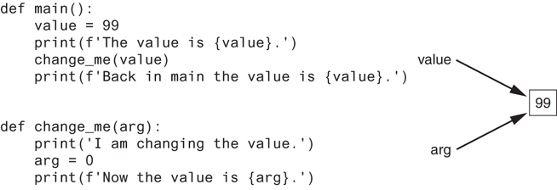
Making Changes to Parameters (2 of 3)
Figure 5-17 The value variable is passed to the change_me function

Slide 41
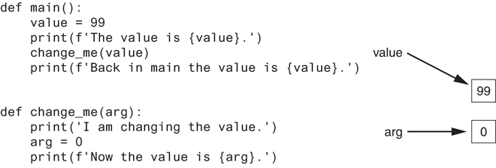
Making Changes to Parameters (3 of 3)
Figure 5-18
The value variable passed to the change_me function cannot be changed by it
Figure 5-18 The value variable is passed to the change_me function

Slide 42
Keyword Arguments
Keyword argument: argument that specifies which parameter the value should be passed to
Position when calling function is irrelevant
General Format:
function_name(parameter=value)
Possible to mix keyword and positional arguments when calling a function
Positional arguments must appear first

Slide 43
Example
def main(): calculate_total_cost(apples=3.50, bread=2.00, milk=1.75, eggs=4.25) def calculate_total_cost(milk, eggs, apples, bread): total=milk+eggs+apples+bread print(f'The total cost of your shopping list is ${total:,.2f}.') main()

Slide 44
Global Variables and Global Constants (1 of 3)
Global variable: created by assignment statement written outside all the functions
Can be accessed by any statement in the program file, including from within a function
If a function needs to assign a value to the global variable, the global variable must be redeclared within the function
General format: global variable_name

Slide 45
Example
my_value = 10 def show_value(): print(my_value) show_value()

Slide 46
Example
number=0 def main(): global number number=int(input('Enter a number: ')) show_value() def show_value(): print(f'the number you entered is {number}') main()

Slide 47
Example
my_value=10 def show_value(): global my_value my_value=my_value+5 print(f'the value is {my_value}') show_value()

Slide 48
Global Variables and Global Constants (2 of 3)
Reasons to avoid using global variables:
Global variables making debugging difficult
Many locations in the code could be causing a wrong variable value
Functions that use global variables are usually dependent on those variables
Makes function hard to transfer to another program
Global variables make a program hard to understand

Slide 49
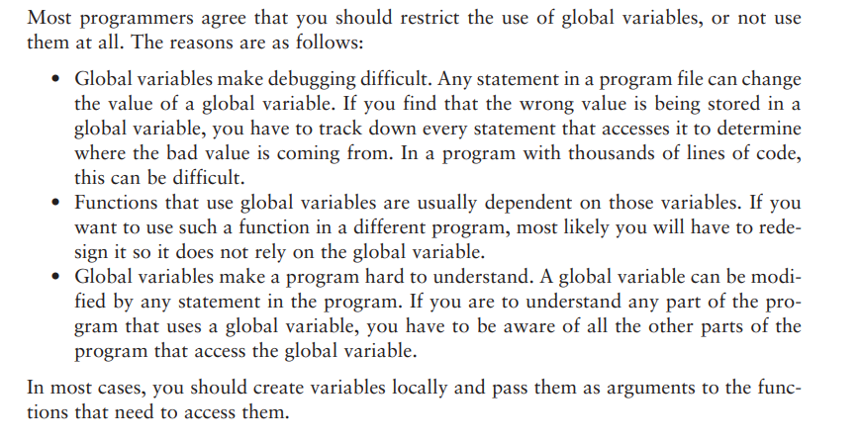
Global Variables and Global Constants (3 of 3)

Slide 50
Global Constants
Global constant: global name that references a value that cannot be changed
Permissible to use global constants in a program
To simulate global constant in Python, create global variable and do not re-declare it within functions

Slide 51
Marilyn works for Integrated Systems, Inc., a software company that gives its employees great extra benefits.
One of the advantages is a bonus that employees get every three months (quarterly).
Another advantage is a retirement savings plan, where the company adds money to each employee’s account.
The company helps employees save for retirement by adding 5% of their salary and bonuses to their retirement savings.
Marilyn wants to create a computer program that will calculate how much money the company adds to an employee’s retirement savings over a whole year.
She wants the program to:
Show how much money is added from the employee’s regular salary.
Show how much money is added from the quarterly bonuses.

Slide 52
Here is an algorithm step-by-step for the program
Get the employee’s annual gross pay.
Get the amount of bonuses paid to the employee.
Calculate and display the contribution for the gross pay.
Calculate and display the contribution for the bonuses.

Slide 53
CONTRIBUTION_RATE=0.05 def main(): pay=float(input('Enter the gross pay: ')) bonus=float(input('Enter the amount of bonus: ')) print() show_pay(pay) show_bonus(bonus) def show_pay(gross): contribution=gross*CONTRIBUTION_RATE print(f'contribution for gross pay is ${contribution}') def show_bonus(bonus): contribution=bonus*CONTRIBUTION_RATE print(f'contribution for bonus is ${contribution}') main()

Slide 54
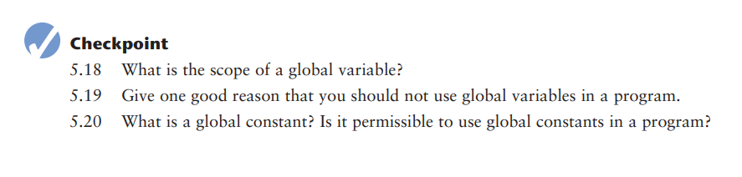

Slide 55
Introduction to Value-Returning Functions: Generating Random Numbers
void function: group of statements within a program for performing a specific task
Call function when you need to perform the task
Value-returning function: similar to void function, returns a value
Value returned to part of program that called the function when function finishes executing

Slide 56
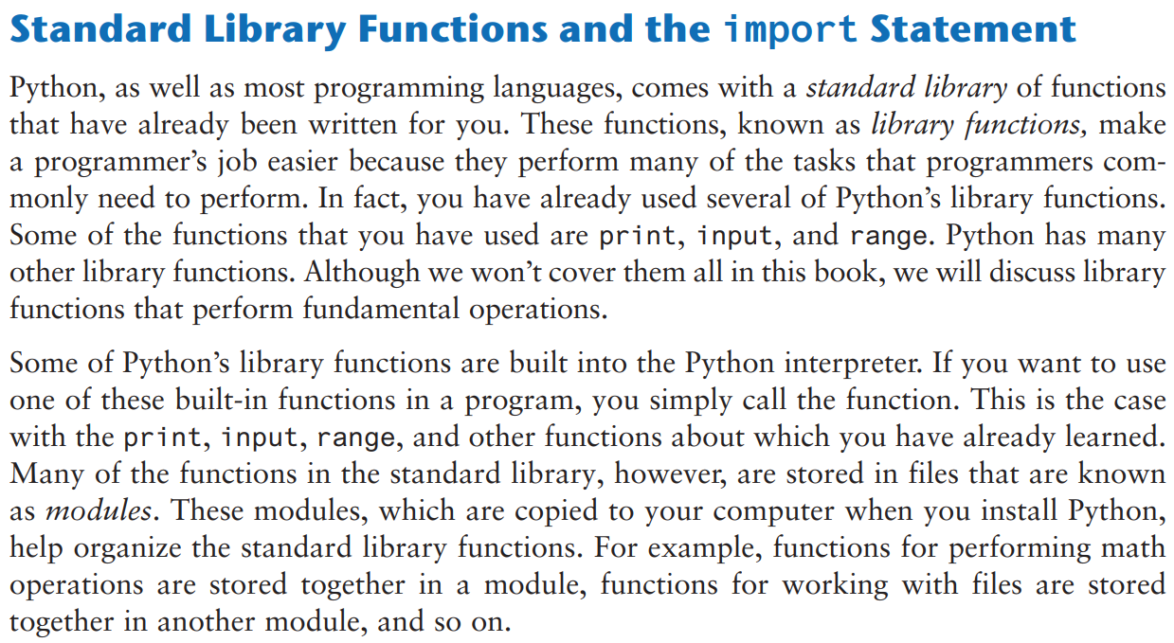

Slide 57
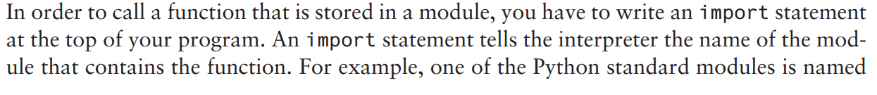
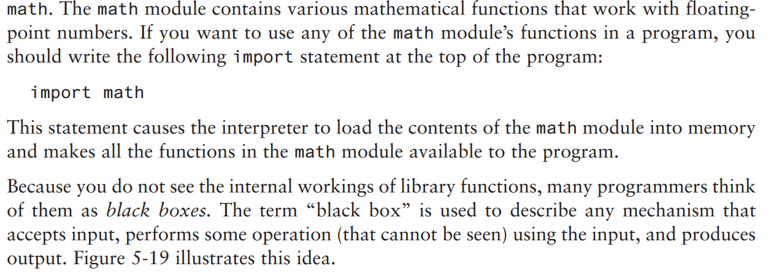

Slide 58
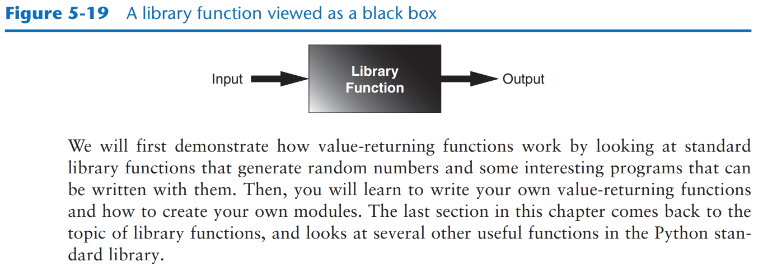

Slide 59
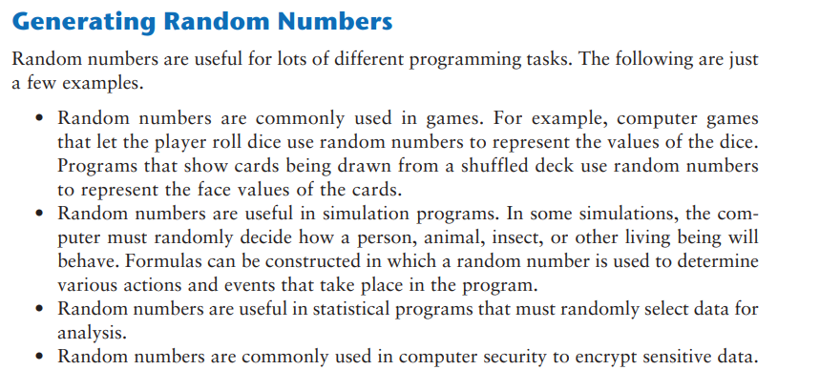

Slide 60
Generating Random Numbers (1 of 5)
Random number are useful in a lot of programming tasks
random module: includes library functions for working with random numbers
Dot notation: notation for calling a function belonging to a module
Format: module_name.function_name()

Slide 61
Generating Random Numbers (2 of 5)
randint function: generates a random number in the range provided by the arguments
Returns the random number to part of program that called the function
Returned integer can be used anywhere that an integer would be used

Slide 62
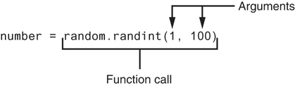
Generating Random Numbers (3 of 5)
Figure 5-20 A statement that calls the random function

Slide 63
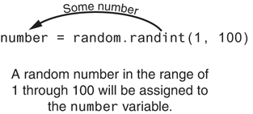
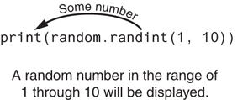
Generating Random Numbers (4 of 5)
Figure 5-21 The random function returns a value
Figure 5-22 Displaying a random number

Slide 64
Example
import random def main(): number = random.randint(1, 10) print(f'The number is {number}.') main()

Slide 65
Example
#This program displays five random
# numbers in the range of 1 through 100.
import random def main(): for count in range(5): number = random.randint(1, 10) print(number) main()
------------------------------------------------------------------------------------
import random def main(): for count in range(5): print(random.randint(1, 100)) main()

Slide 66
Example
import random MIN = 0 MAX = 6 def main(): again = 'y' while again == 'y' or again == 'Y': print('Rolling the dice . . .') print('Their values are:') print(random.randint(MIN, MAX)) print(random.randint(MIN, MAX)) again = input('Roll them again? (y = yes): ') main()

Slide 67
Example
import random HEADS = 1 TAILS = 2 TOSSES = 10 def main(): for toss in range(TOSSES): if random.randint(HEADS, TAILS) == HEADS: print('Heads') else: print('Tails') main()

Slide 68
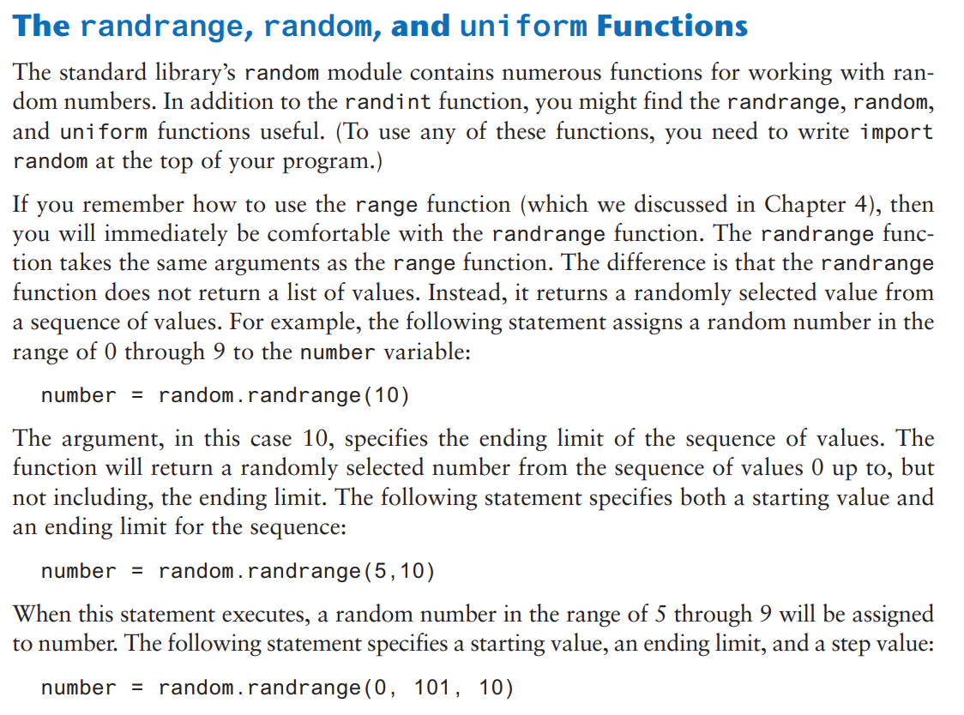

Slide 69
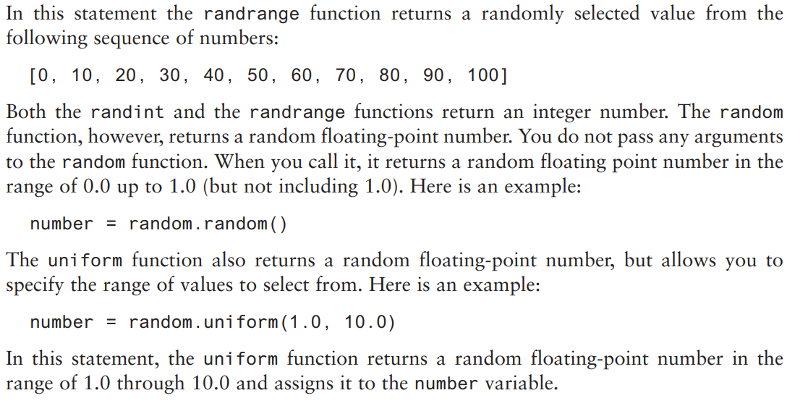

Slide 70
Random Number Seeds
Random number created by functions in random module are actually pseudo-random numbers
Seed value: initializes the formula that generates random numbers
Need to use different seeds in order to get different series of random numbers
By default uses system time for seed
Can use random.seed() function to specify desired seed value

Slide 71
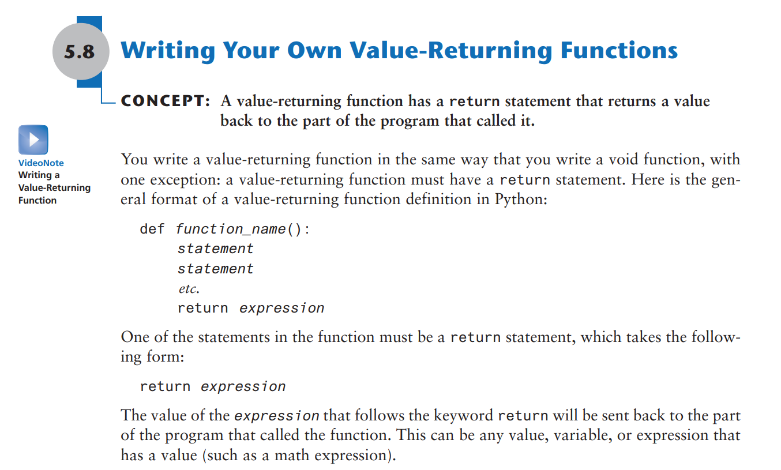

Slide 72
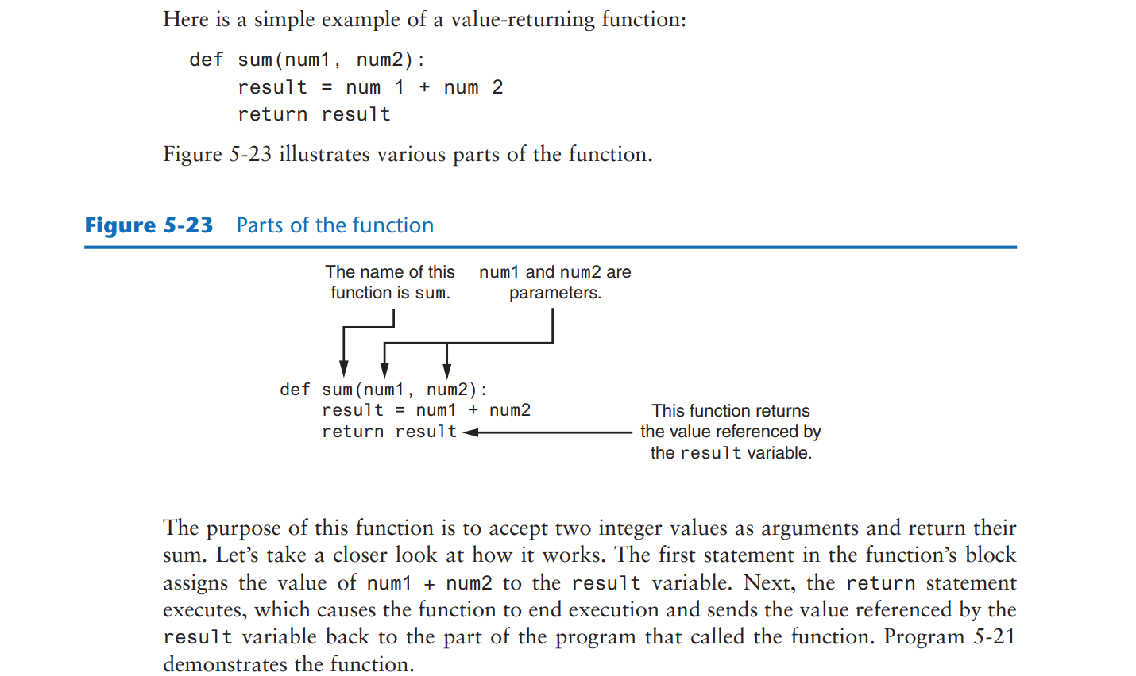

Slide 73
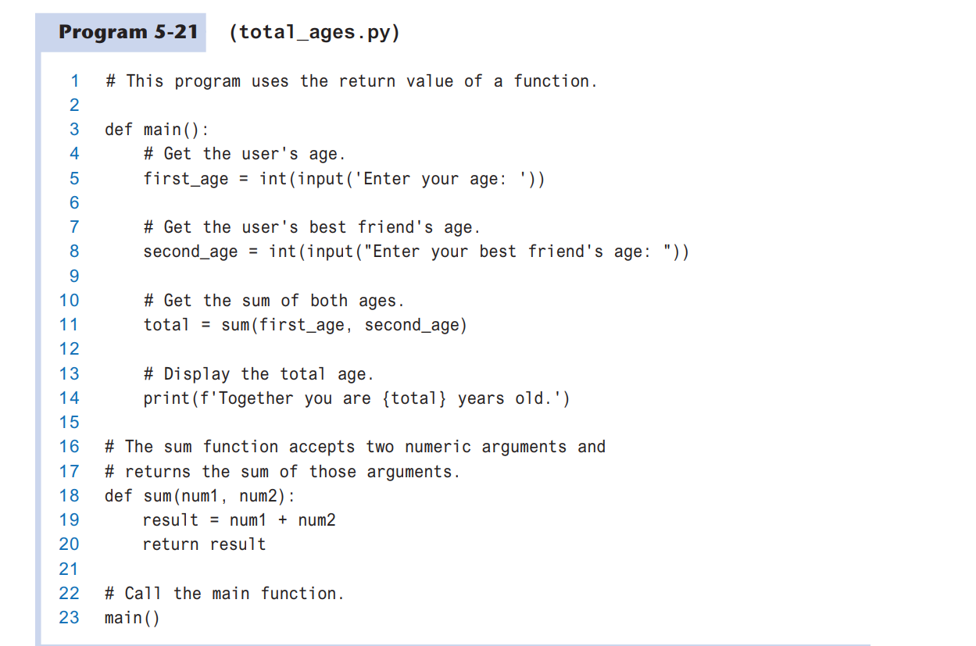

Slide 74
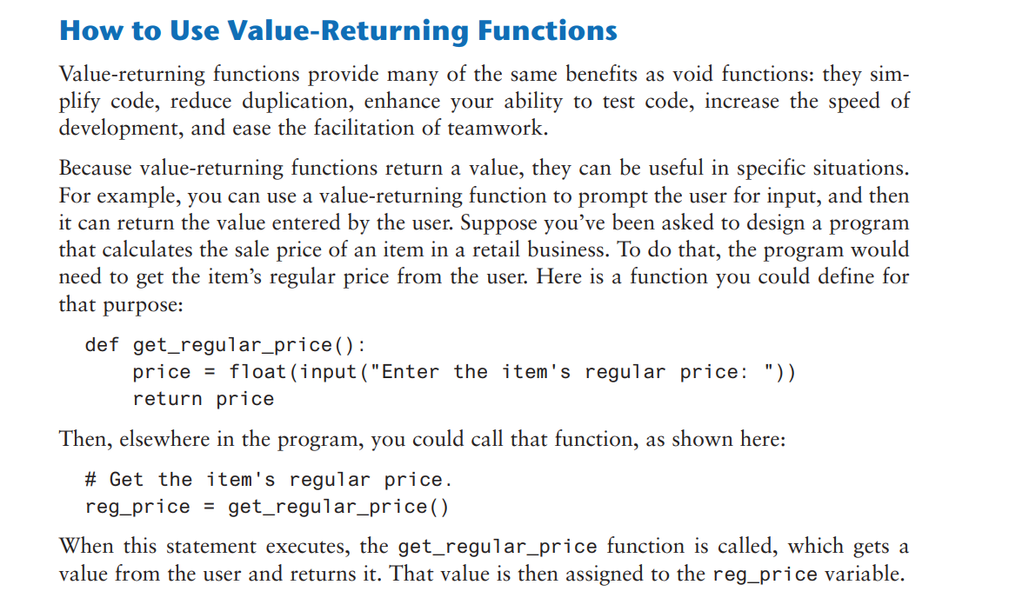

Slide 75
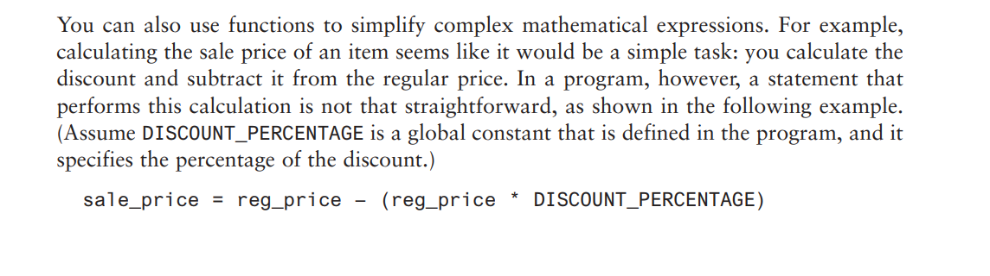
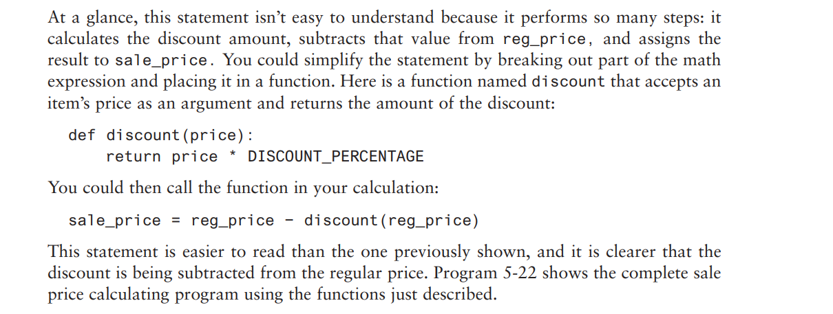

Slide 76
Example
DISCOUNT_PERCENTAGE=0.20 def main(): regular_price=get_regular_price() sales_price= regular_price-discount(regular_price) print(f'The sales price is ${sales_price}') def get_regular_price(): price=float(input("Enter the item's regular price: ")) return price def discount(): return price*DISCOUNT_PERCENTAGE main()

Slide 77
Using IPO Charts (1 of 2)
IPO chart: describes the input, processing, and output of a function
Tool for designing and documenting functions
Typically laid out in columns
Usually provide brief descriptions of input, processing, and output, without going into details
Often includes enough information to be used instead of a flowchart

Slide 78
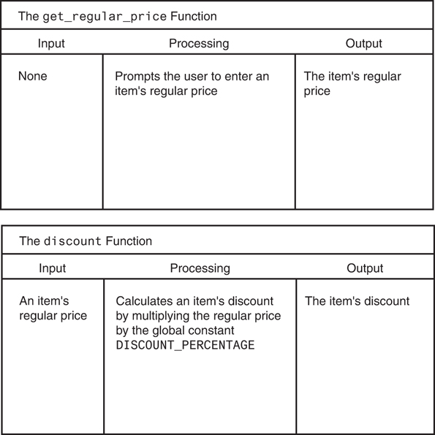
Using IPO Charts (2 of 2)
Figure 5-25 IPO charts for the getRegularPrice and discount functions

Slide 79
Returning Strings
You can write functions that return strings
For example:
def main(): user_name = get_name() print("Your name is:", user_name) def get_name(): name = input('Enter your name: ') return name main()

Slide 80
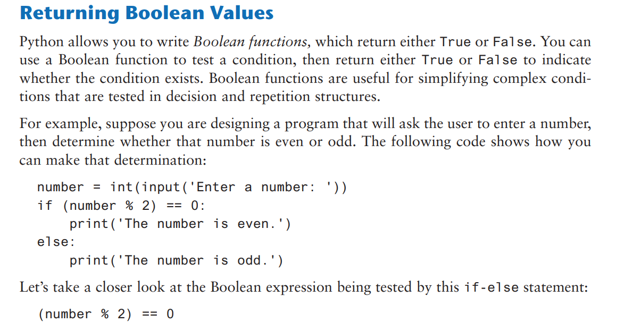

Slide 81
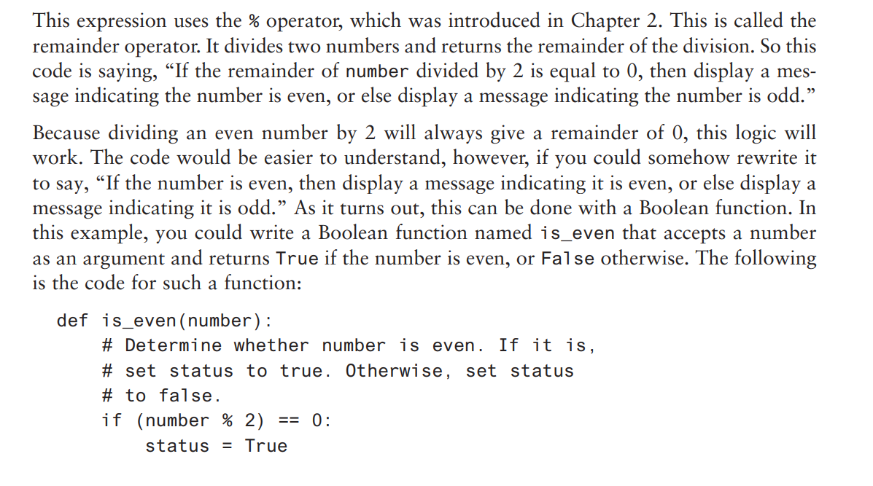

Slide 82
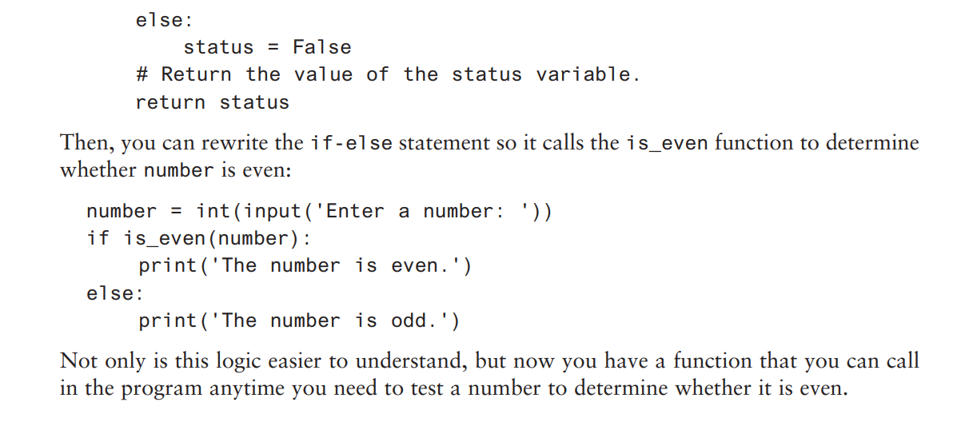

Slide 83
Returning Boolean Values
def is_even(number): return number % 2 == 0 number = int(input("Enter a number: ")) if is_even(number): print(f"{number} is even.") else: print(f"{number} is odd.")

Slide 84
Returning Multiple Values
In Python, a function can return multiple values
Specified after the return statement separated by commas
Format: return expression1,
expression2, etc.
When you call such a function in an assignment statement, you need a separate variable on the left side of the = operator to receive each returned value

Slide 85
Returning Multiple Values
def get_name(): first = input('Enter your first name: ') last = input('Enter your last name: ') return first, last frist_name,last_name=get_name() print(frist_name,last_name)

Slide 86
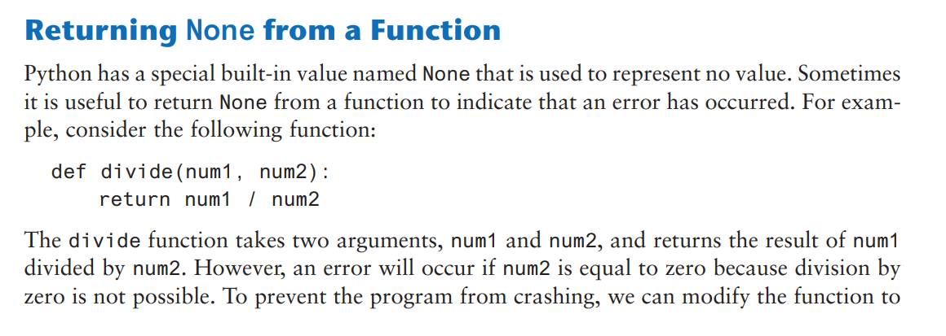
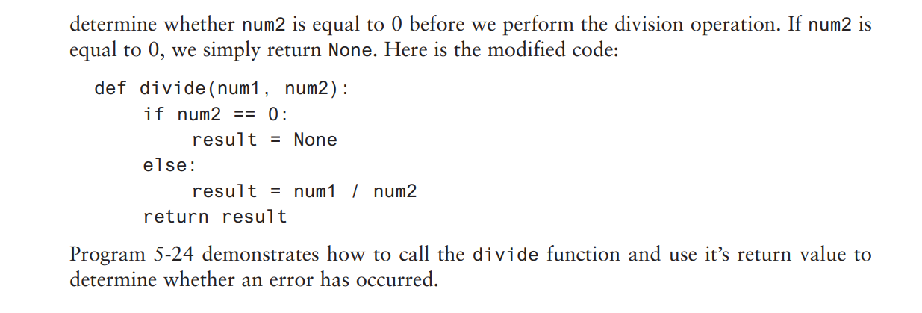

Slide 87
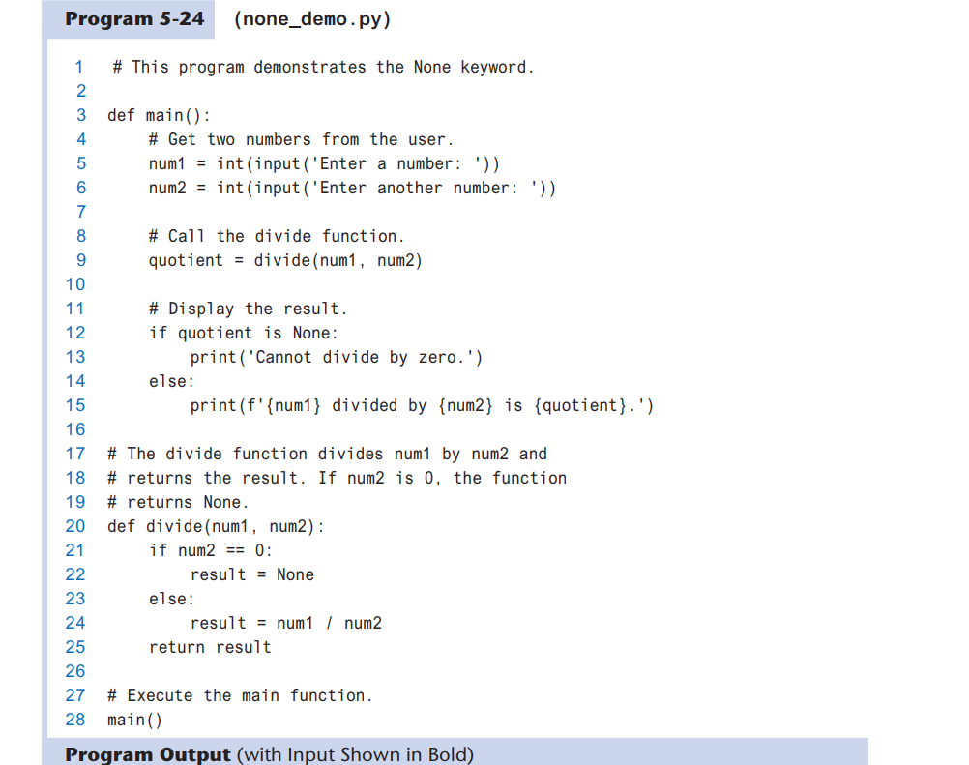

Slide 88
Example
def main(): num1=int(input("Entre num1: ")) num2=int(input("Entre num2: ")) result=divide(num1,num2) print(result) def divide(number1,number2): if number2==0: result=None else: result=number1/number2 return result main()

Slide 89
Example
def main(): num1 = int(input('Enter a number: ')) num2 = int(input('Enter another number: ')) quotient = divide(num1, num2) if quotient is None: print('Cannot divide by zero.') else: print(f'{num1} divided by {num2} is {quotient}.') def divide(num1, num2): if num2 == 0: result = None else: result = num1 / num2 return result main()

Slide 90
The math Module (1 of 3)
math module: part of standard library that contains functions that are useful for performing mathematical calculations
Typically accept one or more values as arguments, perform mathematical operation, and return the result
Use of module requires an import math statement

Slide 91
The math Module (2 of 3)
Table 5-2 Many of the functions in the math module
math Module Function | Description
acos(x) | Returns the arc cosine of x, in radians.
asin(x) | Returns the arc sine of x, in radians.
atan(x) | Returns the arc tangent of x, in radians.
ceil(x) | Returns the smallest integer that is greater than or equal to x.
cos(x) | Returns the cosine of x in radians.
degrees(x) | Assuming x is an angle in radians, the function returns the angle converted to degrees.
exp(x) | Returns e^{x}
floor(x) | Returns the largest integer that is less than or equal to x.
hypot(x, y) | Returns the length of a hypotenuse that extends from (0, 0) to (x, y).
log(x) | Returns the natural logarithm of x.
log10(x) | Returns the base-10 logarithm of x.
radians(x) | Assuming x is an angle in degrees, the function returns the angle converted to radians.
sin(x) | Returns the sine of x in radians.
sqrt(x) | Returns the square root of x.
tan(x) | Returns the tangent of x in radians.

Slide 92
Example
import math def main(): number = float(input('Enter a number: ')) square_root = math.sqrt(number) print(f'The square root of {number} is {square_root}.') main()
import math print(math.ceil(12.3))

Slide 93
The math Module (3 of 3)
The math module defines variables pi and e, which are assigned the mathematical values for pi and e
Can be used in equations that require these values, to get more accurate results
Variables must also be called using the dot notation
Example:
circle_area = math.pi * radius**2

Slide 94
Storing Functions in Modules (1 of 2)
In large, complex programs, it is important to keep code organized
Modularization: grouping related functions in modules
Makes program easier to understand, test, and maintain
Make it easier to reuse code for multiple different programs
Import the module containing the required function to each program that needs it

Slide 95
Storing Functions in Modules (2 of 2)
Module is a file that contains Python code
Contains function definition but does not contain calls to the functions
Importing programs will call the functions
Rules for module names:
File name should end in .py
Cannot be the same as a Python keyword
Import module using import statement

Slide 96
Example
import h1 def main(): num1=int(input("Enter num1: ")) num2=int(input("Enter num2: ")) print('the addition is: ',h1.add(num1,num2)) print('the subtraction is: ',h1.subtract(num1,num2)) print('the multiplication is: ',h1.multiply(num1,num2)) print('the division is: ',h1.divide(num1,num2)) main()
def add(a, b): return a + b def subtract(a, b): return a - b def multiply(a, b): return a * b def divide(a, b): if b != 0: return a / b else: return "Cannot divide by zero"

Slide 97
Menu Driven Programs
Menu-driven program: displays a list of operations on the screen, allowing user to select the desired operation
List of operations displayed on the screen is called a menu
Program uses a decision structure to determine the selected menu option and required operation
Typically repeats until the user quits

Slide 98
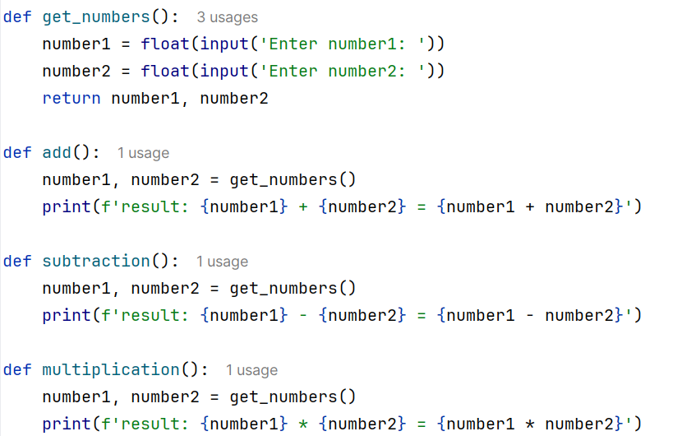

Slide 99
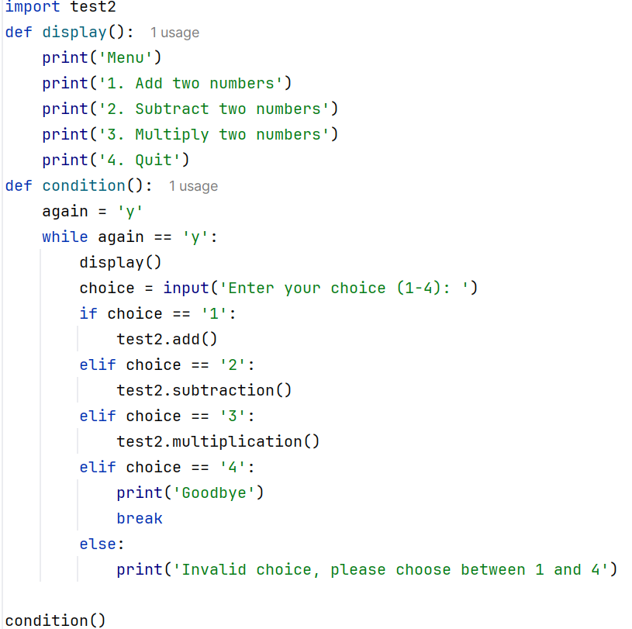

Slide 100
Conditionally Executing the main Function (1 of 3)
It is possible to create a module that can be run as a standalone program or imported into another program
Suppose Program A defines several functions that you want to use in Program B
So, you import Program A into Program B
However, you do not want Program A to execute its main function when you import it

Slide 101
Conditionally Executing the main Function (2 of 3)
In the aforementioned scenario, you write each module so it executes its main function only when the module is being run as the main program
When a source code file is loaded into the Python interpreter, a special variable called __name__ is created
If the source code file has been imported as a module, the __name__ variable will be set to the name of the module.
If the source code file is being executed as the main program, the __name__ variable will be set to the value '__main__'.

Slide 102
Conditionally Executing the main Function (3 of 3)
To prevent the main function from being executed when the file is imported as a module, you can conditionally execute main
def main():
statement
statement
def my_function():
statement
statement
if __name__ == '__main__':
main()

Slide 103
Turtle Graphics: Modularizing Code with Functions (1 of 6)
Commonly needed turtle graphics operations can be stored in functions and then called whenever needed.
For example, the following function draws a square. The parameters specify the location, width, and color.
def square(x, y, width, color):
turtle.penup() # Raise the pen
turtle.goto(x, y) # Move to (X,Y)
turtle.fillcolor(color) # Set the fill color
turtle.pendown() # Lower the pen
turtle.begin_fill() # Start filling
for count in range(4): # Draw a square
turtle.forward(width)
turtle.left(90)
turtle.end_fill() # End filling

Slide 104
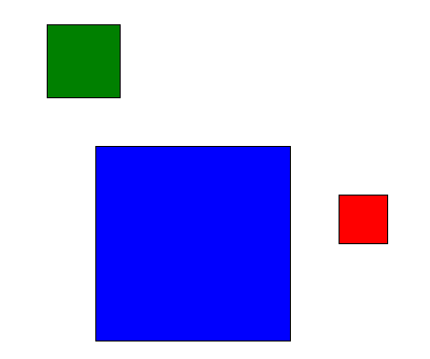
Turtle Graphics: Modularizing Code with Functions (2 of 6)
The following code calls the previously shown square function to draw three squares:
square(100, 0, 50, 'red')
square(-150, -100, 200, 'blue')
square(-200, 150, 75, 'green')

Slide 105
Turtle Graphics: Modularizing Code with Functions (3 of 6)
The following function draws a circle. The parameters specify the location, radius, and color.
def circle(x, y, radius, color):
turtle.penup() # Raise the pen
turtle.goto(x, y - radius) # Position the turtle
turtle.fillcolor(color) # Set the fill color
turtle.pendown() # Lower the pen
turtle.begin_fill() # Start filling
turtle.circle(radius) # Draw a circle
turtle.end_fill() # End filling

Slide 106
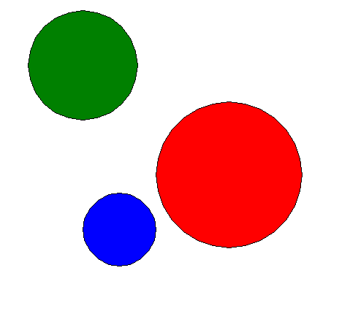
Turtle Graphics: Modularizing Code with Functions (4 of 6)
The following code calls the previously shown circle function to draw three circles:
circle(0, 0, 100, 'red')
circle(-150, -75, 50, 'blue')
circle(-200, 150, 75, 'green')

Slide 107
Turtle Graphics: Modularizing Code with Functions (5 of 6)
The following function draws a line. The parameters specify the starting and ending locations, and color.
def line(startX, startY, endX, endY, color):
turtle.penup() # Raise the pen
turtle.goto(startX, startY) # Move to the starting point
turtle.pendown() # Lower the pen
turtle.pencolor(color) # Set the pen color
turtle.goto(endX, endY) # Draw a square

Slide 108
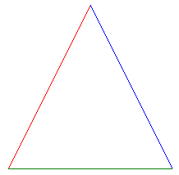
Turtle Graphics: Modularizing Code with Functions (6 of 6)
The following code calls the previously shown line function to draw a triangle:
TOP_X = 0
TOP_Y = 100
BASE_LEFT_X = -100
BASE_LEFT_Y = -100
BASE_RIGHT_X = 100
BASE_RIGHT_Y = -100
line(TOP_X, TOP_Y, BASE_LEFT_X, BASE_LEFT_Y, 'red')
line(TOP_X, TOP_Y, BASE_RIGHT_X, BASE_RIGHT_Y, 'blue')
line(BASE_LEFT_X, BASE_LEFT_Y, BASE_RIGHT_X, BASE_RIGHT_Y, 'green')

Slide 109
Summary (1 of 2)
This chapter covered:
The advantages of using functions
The syntax for defining and calling a function
Methods for designing a program to use functions
Use of local variables and their scope
Syntax and limitations of passing arguments to functions
Global variables, global constants, and their advantages and disadvantages

Slide 110
Summary (2 of 2)
Value-returning functions, including:
Writing value-returning functions
Using value-returning functions
Functions returning multiple values
Using library functions and the import statement
Modules, including:
The random and math modules
Grouping your own functions in modules
Modularizing Turtle Graphics Code

